Slide 1
Case study

Slide 2
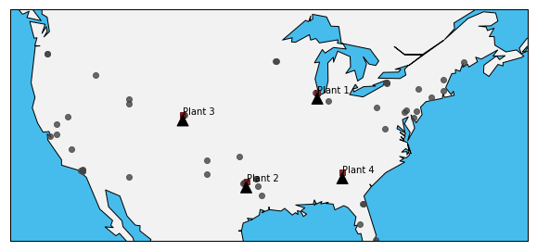
Initial plant and customers

Slide 3
Given Details
Each plant produces only 1 type of materials except plant 4, which produce type 4,5
Total transportation cost for each quarter = 75031219.44

Slide 4
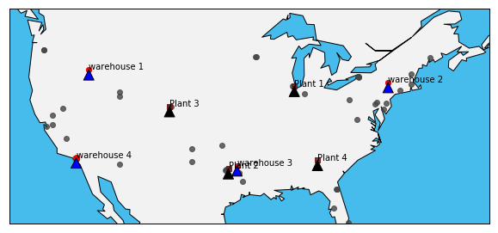
Warehouse location stratergy
By Placing warehouse at locations 8, 13, 17, 25 we can satisfy more than 80% of the demand within 500 miles of radius

Slide 5
Total Savings in Transportation cost
Total transportation Cost without warehouses= 75,031,219.44 (Quarterly)
More time for some of the customers which are far away from the plant
Total transportation cost by placement of warehouses= 32,742,243.10 (Quarterly)
Stock can be stored and then sent

Slide 6
Conclustion
More than half transportation cost can be saved by placement of Warehouses each quarter by just placing 4 warehouses.
Timely delivery of products can be done to customers.

